Slide 1
CSM51A Discussion #5
Hyunjin Kim

Slide 2
Outline
Midterm Review
Chapter 8
Various Flip-Flops
Design with flip-flops

Slide 3
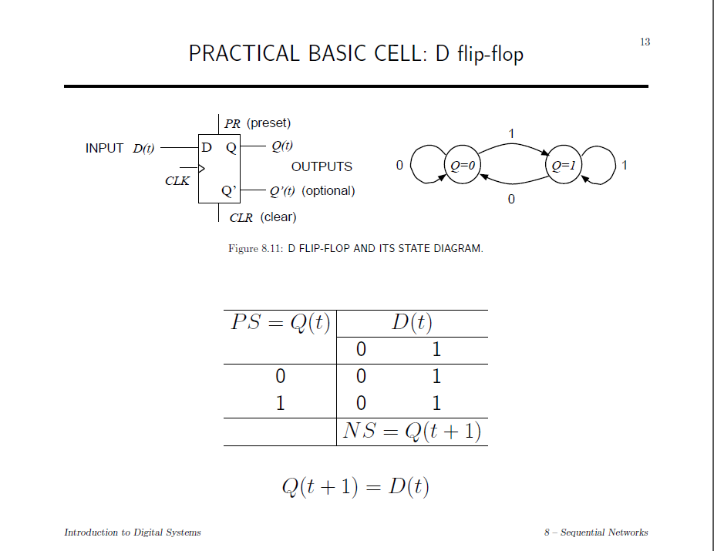

Slide 4
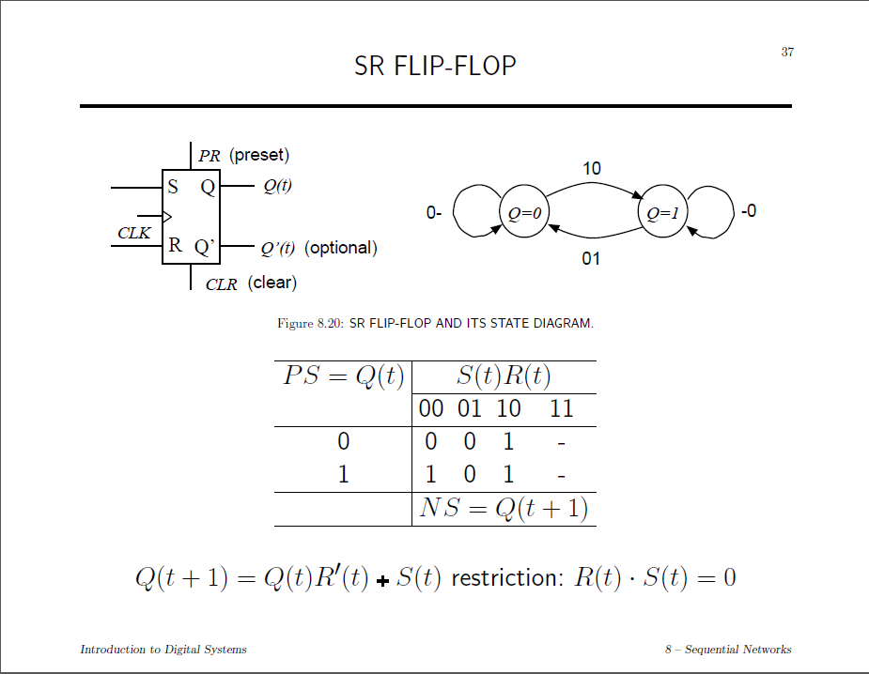

Slide 5
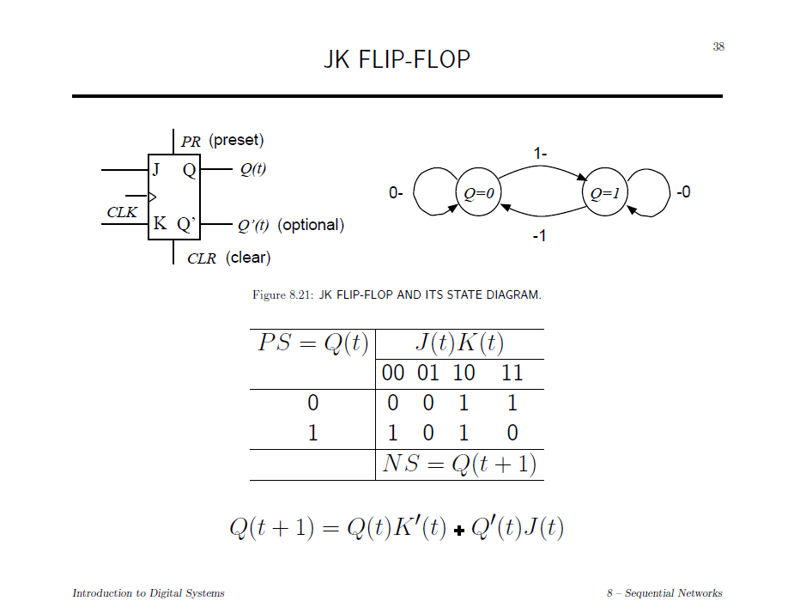

Slide 6
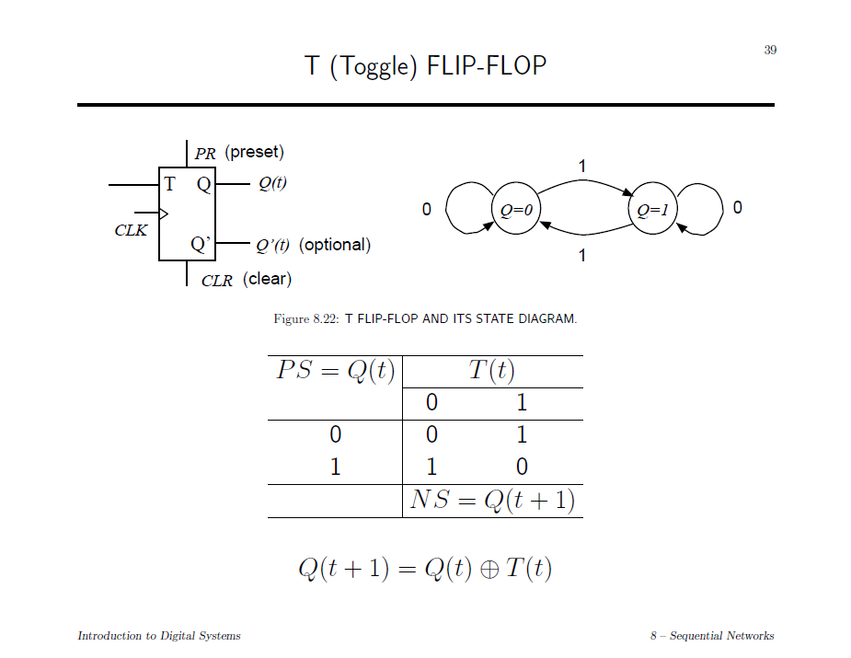

Slide 7
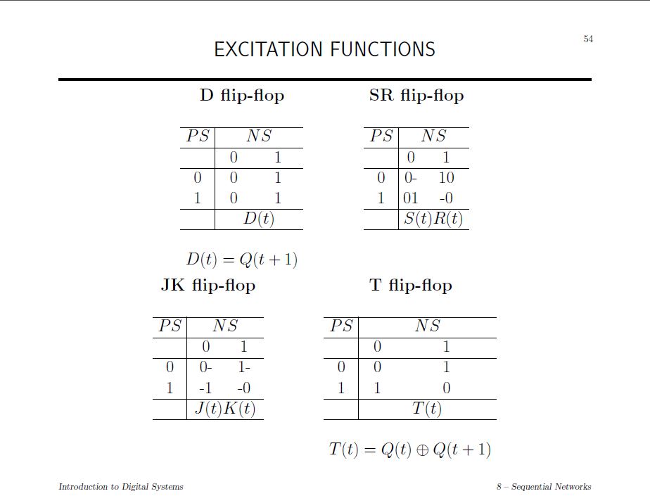

Slide 8
Implement FF using diff FF
D flip-flop using JK flip-flop
T flip-flop using SR flip-flop
JK flip-flop using T flop-flop
Q(t) | Q(t+1) | S | R
0 | 0 | 0 | -
0 | 1 | 1 | 0
1 | 0 | 0 | 1
1 | 1 | - | 0
Q(t) | Q(t+1) | D
0 | 0 | 0
0 | 1 | 1
1 | 0 | 0
1 | 1 | 1
Q(t) | Q(t+1) | J | K
0 | 0 | 0 | -
0 | 1 | 1 | -
1 | 0 | - | 1
1 | 1 | - | 0
Q(t) | Q(t+1) | T
0 | 0 | 0
0 | 1 | 1
1 | 0 | 1
1 | 1 | 0

Slide 9
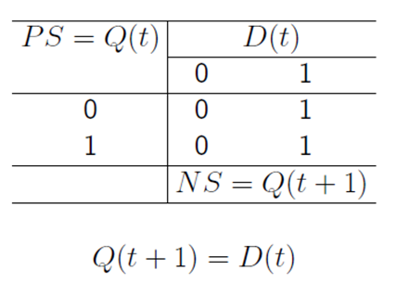
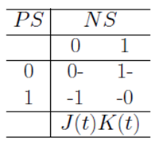
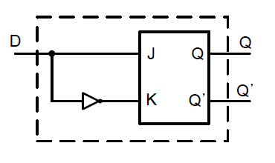
D-FF using JK-FF
Excitation Table of JK-FF
Q(t) | Q(t+1) | D
0 | 0 | 0
0 | 1 | 1
1 | 0 | 0
1 | 1 | 1
Q(t) | Q(t+1) | J | K
0 | 0 | 0 | -
0 | 1 | 1 | -
1 | 0 | - | 1
1 | 1 | - | 0

Slide 10
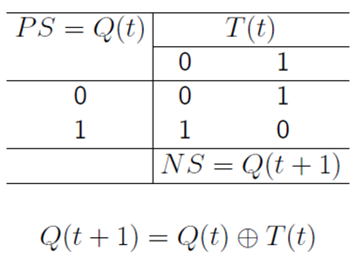
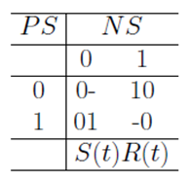
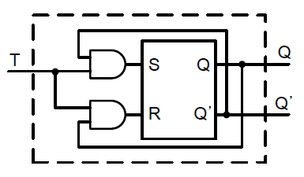
T-FF using SR-FF
Excitation Table of SR-FF
Q(t) | Q(t+1) | T
0 | 0 | 0
0 | 1 | 1
1 | 0 | 1
1 | 1 | 0
Q(t) | Q(t+1) | S | R
0 | 0 | 0 | -
0 | 1 | 1 | 0
1 | 0 | 0 | 1
1 | 1 | - | 0

Slide 11
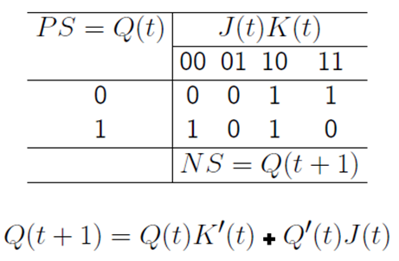
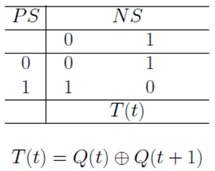
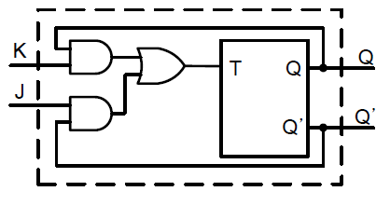
JK-FF using T-FF
Excitation Table of T-FF
Q(t) | Q(t+1) | J | K
0 | 0 | 0 | -
0 | 1 | 1 | -
1 | 0 | - | 1
1 | 1 | - | 0
Q(t) | Q(t+1) | T
0 | 0 | 0
0 | 1 | 1
1 | 0 | 1
1 | 1 | 0

Slide 12
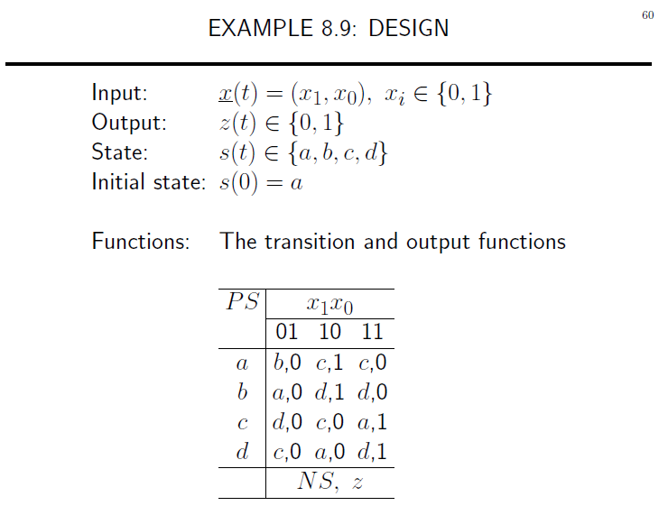

Slide 13
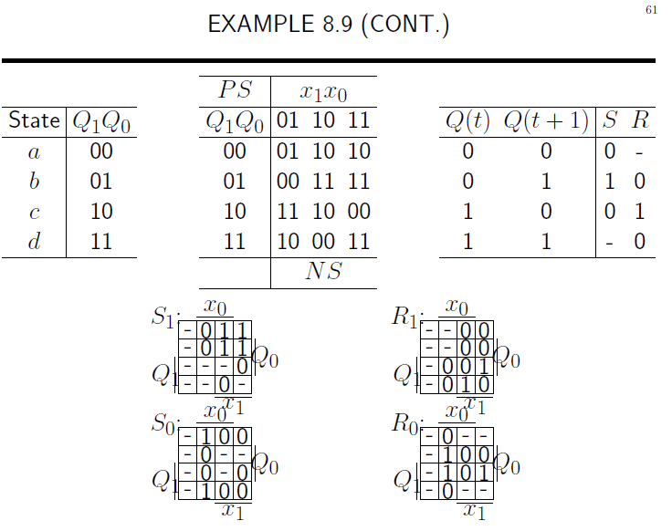

Slide 14
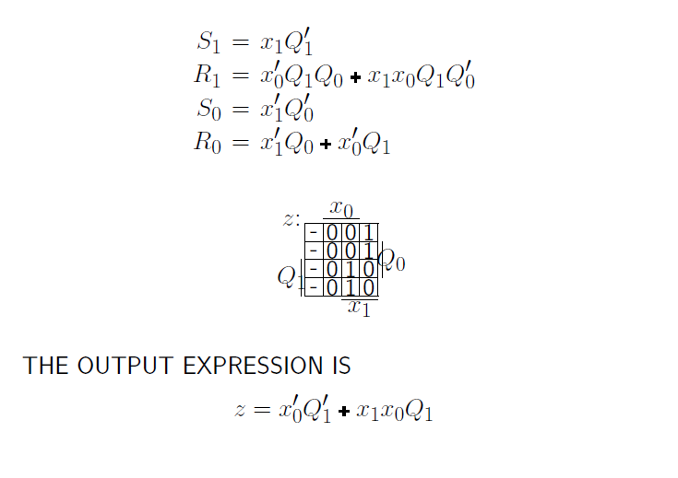

Slide 15
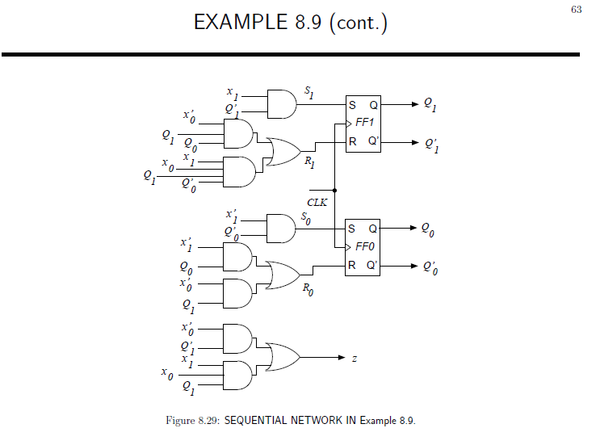

Slide 16
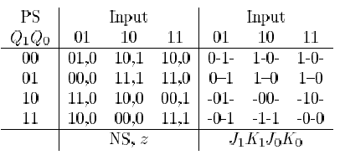
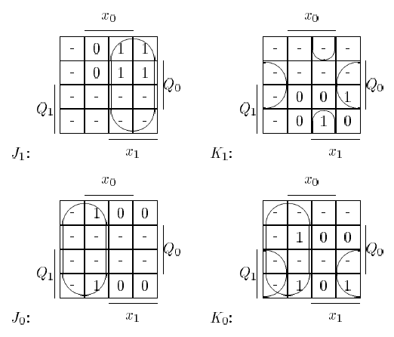
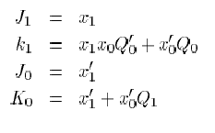
EXAMPLE 8.9 with JK

Slide 17
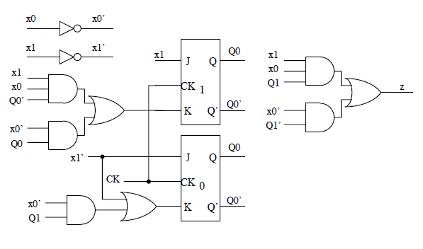
EXAMPLE 8.9 with JK

Slide 18

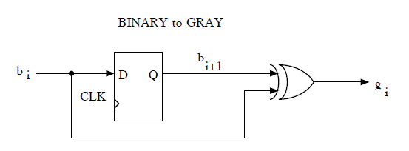
Ex 8.10
Implement a sequential (bit-serial) network for converting an n-bit representation of an integer from binary code to Gray code. Use the fact that g_{i} = b_{i} XOR b_{i+1}, where b_{i} is the ith bit of the binary representation and g_{i} is the corresponding bit of the Gray Code

Slide 19
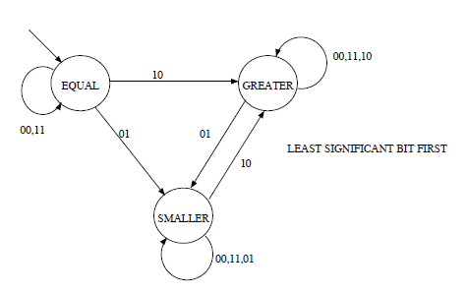
Ex 8.12
Implement a sequential (bit-serial) binary magnitude comparator for 16-bit operands. Describe two implementations: one beginning with the least-significant bit.

Slide 20
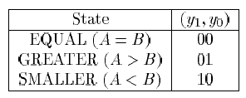
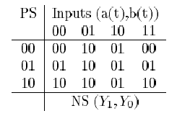
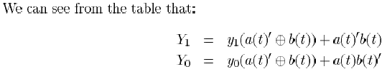
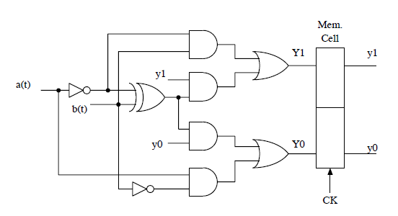

Slide 21
Ex 8.24
Design a sequential network that has one binary input x and one binary output z. The output at time t has value 1 whenever x(t-3, t) has an odd number of 1’s. Overlapping sequences are acceptable; for example, for the input sequence
X(t-7, t) = 010111111
The output sequence is
Z(t-7, t) = ???01100
Use D flip-flops.

Slide 22
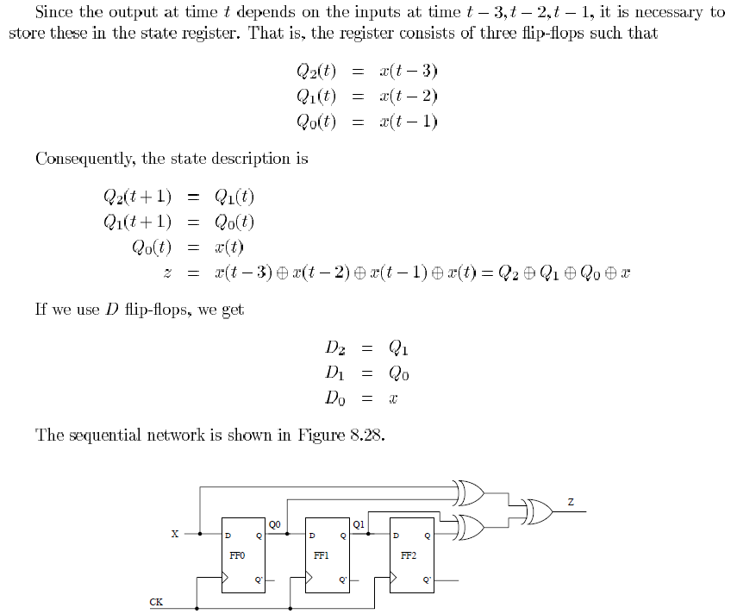

Slide 23
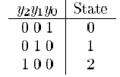
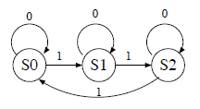
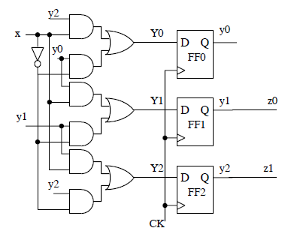
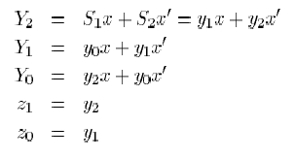
Ex 8.32
Design a modulo-3 binary counter using the “one flip-flop per state” approach. The output is in the binary code

